Slide 1

ATULYA Smart stick for the visually impaired
NAME: AYANTIKA CHATTERJEE
ADM NO: 21JE0202

Slide 2
PROBLEM STATEMENT:
People who are visually impaired often find it incredibly difficult to navigate life because of their physical limitations. They have to depend on others to help them move around, even inside their own home.
Even when they are alone, family and friends are, quite understandably, worried about them and would like to be informed about their whereabouts.
Using sticks to move around is the only affordable solution to their problem. But sticks are primitive and are often useless.

Slide 3
PROPOSED SOLUTION
We aim to provide visually impaired people a product that would help them navigate life respectfully and make them independent.
We will produce a smart stick which will be able to detect the presence of
objects. Also, as the distance of the object from the user increases, the
frequency of the sound produced increases and hence the user is also able to estimate the position of the object.
If the user gets gets lost for some reason, they can click a push button and the location of the user will be sent to a pre-decided mobile number through a SMS.

Slide 4
COMPONENTS
1. Arduino UNO Board
2. Connecting Wires
3. Resistors
4.Piezo buzzer
5. GPS module: NEO-6m
6. GSM Module
7.Breadboard
8.Push button
9.Ultrasonic sensor

Slide 5
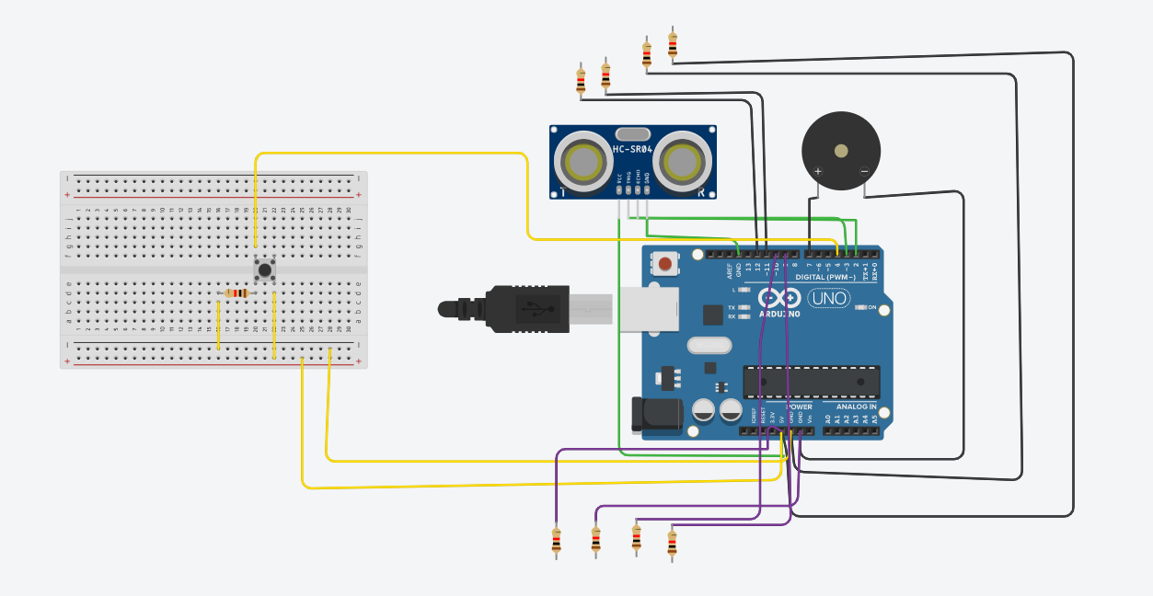
CIRCUIT
GND
VCC
GPS MODULE
TXD
RXD
GND
GSM MODULE
5v
TX
RX

Slide 6
BLOCK DIAGRAM
USER
DEVICE
SMARTPHONE
ULTRASONIC
SENSOR
ACTIVATED
START DEVICE
DISTANCE<40m
BUZZER ACTIVATED
GPS MODULE ACTIVATED
PUSH BUTTON
SMS RECEIVED
GSM MODULE ACTIVATED

Slide 7
IDEAS
1.We could connect the GPS co-ordinate to google maps to make it more convenient for the user who gets the SMS.
2. We could add a buzzer such that the frequency of the sound increases as the distance between the stick and the object increases and hence the user is able to detect moving objects.
3. We could add a WiFi component to it.

Slide 8
RESOURCES
1. Wikipedia
2. Arduino Project Hub
3. YouTube

Slide 9
THANK YOU

